Slide 1

Privacy Preserving Data Mining
Knowledge Discovery (CP-8305)

Slide 2






AGENDA
Introduction
Problem Statement
Problem Solution
Innovative Ideas
Practical Applications
Conclusions and
Future Work

Slide 3
INTRODUCTION

Slide 4
WHAT IS PPDM?
Privacy Preserving Data Mining (PPDM) is a systematic approach to protecting the privacy and intellectual property of data owners, data users, and other parties involved in data mining activities.

Slide 5
DATA IS KEY!
Data is the key understanding traffic
Data is the key to good & well-trained models
Data is the key to prediction, anomaly detection, traffic engineering, etc.
But, good data is hard to get…

Slide 6
WHY IS DATA HARD TO GET?
Companies are reluctant to share their data
  They don’t want to reveal their internal critical data
    Afraid of misuse of data
    Afraid of getting business secrets leaked/exposed
    Afraid of getting incompetency revealed
  Sometimes they are not allowed to
    Privacy legislation

Slide 7
MOTIVATION
Changes in technology making privacy tougher
New challenges in statistics
Data mining plays an outstanding tole in collaboration
Traditional approaches have been too rigid, “all or nothing”
Innovative approaches required to enforce privacy concerns during data
[1] ttps://www.cbc.ca/news/science/what-happens-to-the-e-waste-you-drop-off-for-recycling-1.5101357
[2] https://hej-support.org/sound-e-waste-management-in-canada-is-there-a-room-for-improvement/

Slide 8
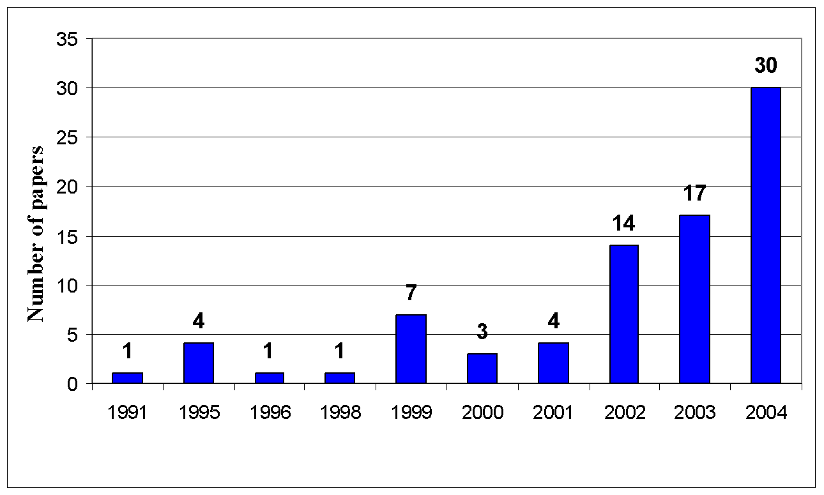
PPDM INCREASING TRENDS
Conceptive Landmark
Deployment Landmark

Slide 9
PRIVACY VIOLATION
Privacy violation means misuse of data and breach of trust
Defining privacy preservation in data mining:
  Individual Privacy Preservation: protecting personally identifiable information
  Collective Privacy Preservation: protecting users’ collective activity data

Slide 10
EXAMPLE SCENARIOS
Scenario 1: A medical data analysis company offers service for disease prediction to customers based on their medical history. The company wants to use state-of-the-art models while preserving customers’ privacy
Scenario 2: Companies who do not have their own data office, often outsource their data to third-parties in order extract knowledge/information from it and make informed decisions. Such companies never want to expose their customers’ private data.
Scenario 3: A teaching hospital develops new treatment procedures, and it compiles patient data sets, it wants to make these data sets available for model training by preserving its patients’ privacy

Slide 11
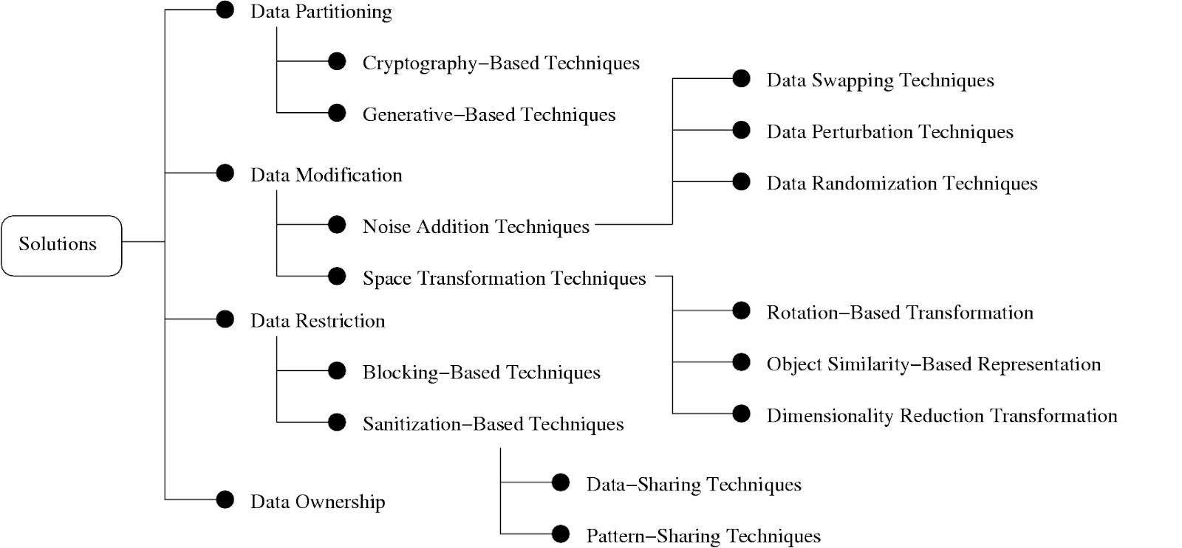
TAXONOMY OF POPULAR SOLUTION
contributions

Slide 12
PROBLEM STATEMENT

Slide 13

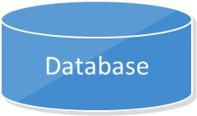
PROBLEM DEFINITION
To transform a database into a new one that conceals sensitive information while preserving general patterns and trends from the original database.
Non-sensitive Patterns
Transformation Process
Data Mining
Original Database
Transformed Database
Clients

Slide 14
APPROACHES

Slide 15
PRACTICAL APPLICATIONS
Real world scenarios
Possible Linkage attack on Netflix Dataset (By linking it with IMDB data)
Database released by Massachusetts hospitals (Linking it with a public voter database)
New York Taxi data (By linking it Celebrity photos from Celebrity gossip website)
Notes:
Hello Guys, Here I am going to discuss some real world scenarios.

Slide 16

Scenario 1 : Netflix Dataset
Netflix Prize
2006
100 M Ratings
500K Users
For more than 17K Movies
Notes:
The first scenario is Netflix Dataset. Netflix is the popular entertainment platform where we can watch movies, tv shows and documentaries by paying monthly fees for subscription. In 2006, Netflix started competition called Netflix prize. So, competing team had to create an algorithm that could predict how someone would rate a movie.
To help with this challenge Netflix provide a Dataset containing over 100 M Ratings submitted by 500K users for more than 17 thousand Movies.

Slide 17
Does Netflix anonymized Data?
Name | Shows/Movies | Ratings
Alex | Breaking Bad
Bob | Friends
Christine | How I Met your Mother?
Ahmed | Prison Break

Slide 18
Yes, but this anonymous method prevent the privacy of users?
Name | Shows/Movies | Ratings
1FVEVDSE | Breaking Bad
73SAFME34 | Friends
45DSEV | How I Met your Mother?
3DCER | Prison Break
Notes:
Netflix of course Anonymized this data by removing the name of users and by replacing some ratings with fake and random ratings. So it is sound anonymize but was it?

Slide 19
IMDb
Internet Movie Database
Individual can sign up for an account and can rate the movies / tv shows
No need to be anonymous while rating
Ratings are visible with dates and comments

Slide 20
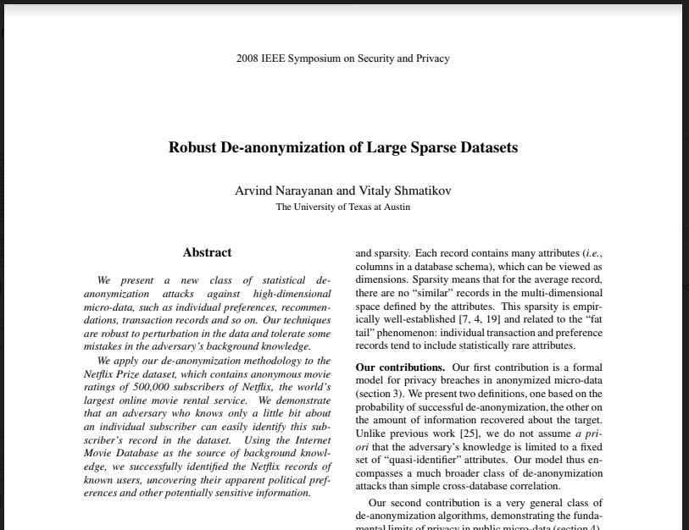
The answer is No, it was not.
Notes:
The answer is No, it was not. Scientists from University of Texas successfully identified people by combining it with data from IMDBs.

Slide 21
The answer is No, it was not.
Notes:
The answer is No, it was not. Scientists from University of Texas successfully identified people by combining it with data from IMDBs.

Slide 22
Linkage attack
+
IMDb
Notes:
These type of attacks known as Linkage attack. It can happened when pieces of seemingly anonymous data can be combined to reveal real identities.

Slide 23
Scenario 2
In 1990, Governor of Massachusetts, USA's Group Insurance commission decided to publish the hospital visits of state employees.
Data was also anonymized by removing names, addresses and other field that could identify people.
However, Scientists Latanya Sweeney from Carnegie Mellon University showed that how easy to reverse this and possible to get identity of patients.

Slide 24
Data from Health Records
Name
SSN
DATE OF VISIT
DIAGNOSIS
PROCEDURE
MEDICATION
TOTAL CHARGE
Diagnosis
Data from Voter ID
Name
Address
Registration Date
Party affiliation
Date last voted
http://ggs685.pbworks.com/w/file/fetch/94376315/Latanya.pdf
Notes:
So here is the records which is published in public by removing Name and Social security number. Later she bought data of Voter list of that state. Which contains these all details.

Slide 25
Studies proves that 87% of Americans can be identified with their Zip code, birthdate and Sex.
-Lavanya Sweeney
Data from Health Records
Name
SSN
DATE OF VISIT
DIAGNOSIS
PROCEDURE
MEDICATION
TOTAL CHARGE
Diagnosis
Data from Voter ID
Name
Address
Registration Date
Party affiliation
Date last voted
Zip
Birthdate
Sex
Notes:
By combining both records, Author successfully identify Zip, birthdate and Sex of person. Author also able to In US, by study it was proven that 87% of Americans can be identified by these 3 pieces of IDs.

Slide 26
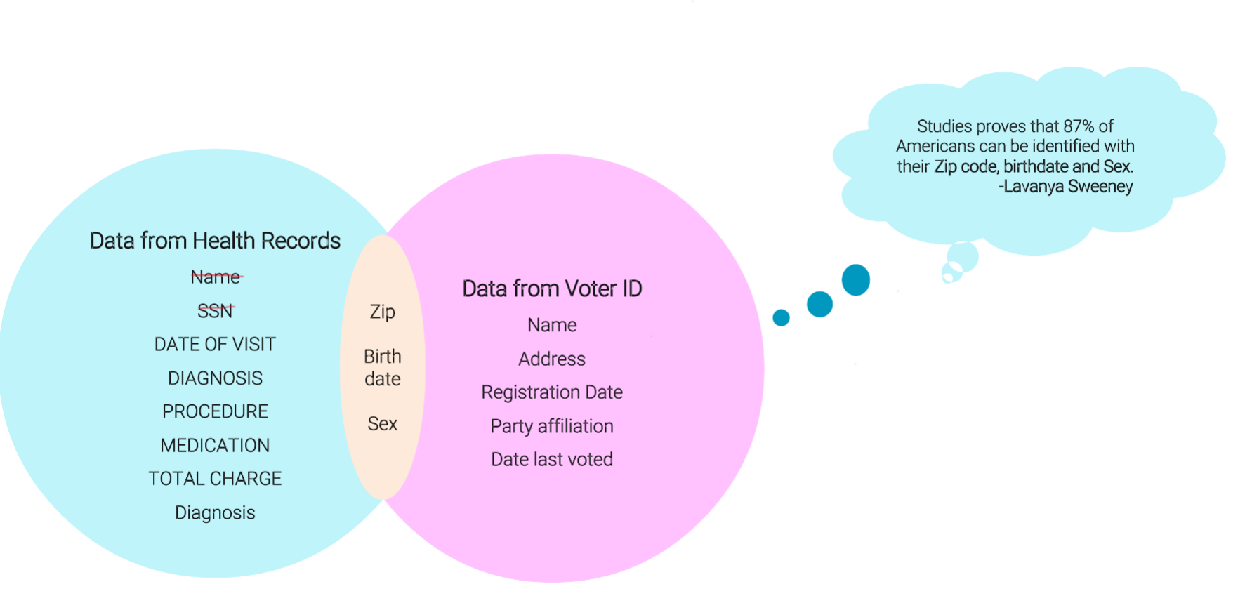

Slide 27
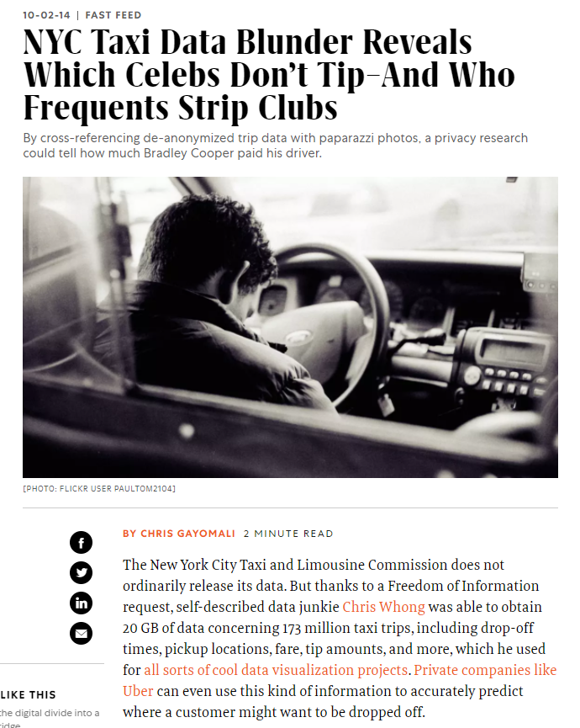
NYC Taxi Data (Anthony Tocker)
Taxi Data
+
Images From Celebrity Gossip website
https://www.fastcompany.com/3036573/nyc-taxi-data-blunder-reveals-which-celebs-dont-tip-and-who-frequents-strip-clubs
Notes:
Antony Tocker combined Newyork Taxi data with Photographs from celebrity gossip website and able to find which celebrity went where and how much they paid or how much they gave tip. So, who would have thought that this can be also possible. So anonymization is not the perfact solution for large data set.

Slide 28
So, What is the Lesson from this Incidents?
For Large Dataset, Anonymization is not a perfect Solution
There is all kinds of data available online. So, if you want publish your dataset, you don't know which dataset can combined with it. Moreover, surprisingly, there is possibility that after 5 years someone will come with new data and that can link with yours and compromise the privacy.

Slide 29
What is the best solution to prevent this type of attack?
Differential Privacy: If there is large amount of data and many more outliers, differential Privacy is giving accurate results.
Definition: A gives € - differential privacy if for all pairs of data sets D1, D2 differing in the data of one person, and all events S.
Calibrating Noise to Sensitivity in Private Data Analysis by Cynthia Dwork, Frank McSherry, Kobbi Nissim, Adam Smith. In Theory of Cryptography Conference (TCC), Springer, 2006. doi:10.1007/11681878_14. The full version appears in Journal of Privacy and Confidentiality, 7 (3), 17-51.
Notes:
D1 is 1st data set and D2 is second dataset. So probabilty distribution between these two dataset is given by epsilon.

Slide 30

Sex | Blood | **** | Diabetes?
F | B | **** | Y
M | A | **** | N
F | O | **** | Y
M | A | **** | N
"" | "" | "" | ""
Randomized Algorithm
Analyst
Sex | Blood | **** | Diabetes?
F | B | **** | Y
F | O | **** | Y
F | O | **** | Y
M | A | **** | N
"" | "" | "" | ""
Randomized Algorithm
Analyst

Slide 31
How Differential Privacy is achieved?(2006)
It is achieved by injecting small amount of Noise into statistical computations.to obscure the effect of each individual while still allowing useful statistical signal to come through.
More Precisely, for any two dataset, these datasets that differ on one individual's data. Like a dataset with your data in it and one with your data removed or modified. The probability distribution of result should be the almost same.
How close these probability distribution are between these two tables? Is given by privacy loss parameter, often denoted epsilon. The small value of epsilon, the greater the level of privacy protection. So, mathematical defination of differential privacy is as per below.

Slide 32
Flip of the coin example
$
1/2
1/2
:
Tails
Heads
1/4
Heads
$
1/2
1/2
Tails
No
Yes
Real answer (Yes)
Notes:
Suppose Professor wants to run survey in the class that does students are comfortable with online study or not. And let's say Student Salman clicks on Yes. Then algorithm flip the coin. If it is heads then algorithms send real answer to the server. If it is tails then algorithm again flips the coin and Send No if it is Heads or Send Yes if it is tails. So, there is ¼ chance of wrong answer. So Professor does not gonna know which student say yes or no. This example is just a simple one. Real world data used different algorithms such as Laplace distribution to increase the anonymity.

Slide 33
Which Industries are using Differential Privacy?
Google
Apple
Microsoft
Uber
U.S Census Bureau
Notes:
Many famous tech and other large industries are using differential privacy including Google, Apple, Microsoft, Uber and Many more. All big industries are developing their own algorithm for differential privacy.

Slide 34
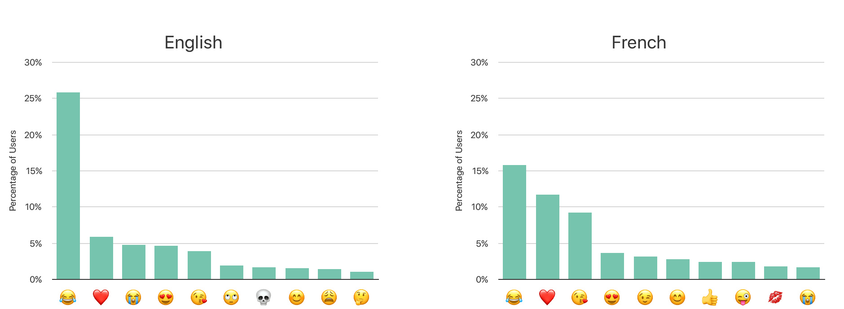
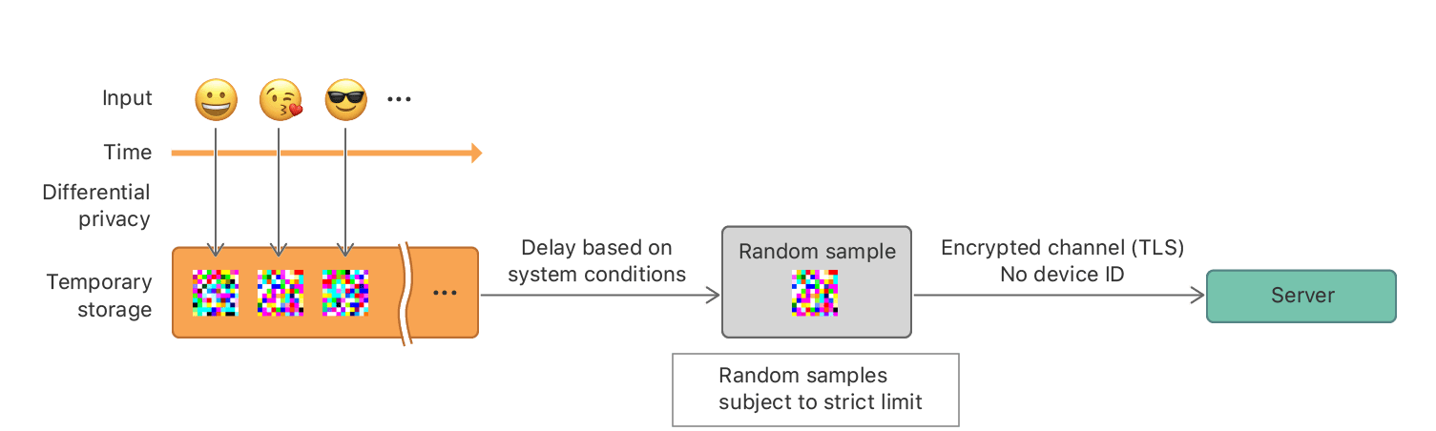
Differential Privacy used by Apple
https://machinelearning.apple.com/research/learning-with-privacy-at-scale
https://docs-assets.developer.apple.com/ml-research/papers/learning-with-privacy-at-scale.pdf
Notes:
So In 2016, Apple decided to collect data from ios 10 and same year Safari version. Apple wanted to study which emoji are more popular in English and French language speaking countries. So here is Privcay model developed by Apple. Whenever an event is generated on device, the data is immediately privatized via -local differential privacy and temporarily stored on-device using data protection [1], rather than being immediately transmitted to the server. After a delay based on device conditions, the system randomly samples from the differentially private records subject to the above limit and sends the sampled records to the server. These records do not include device identifiers or timestamps of when events were generated. The communication between a device and the server is encrypted using TLS. See Figure 2 for an overview. Transport Layer Security (TLS) encrypts data sent over the Internet to ensure that hackers are unable to see what you transmit as it uses symmetric-key encryption to provide confidentiality. Here total 3 algorithms were used by apple. Which are crypo based algorithm and they are using Hash function to store data.
Count Mean Sketch, Hadamard Count Mean Sketch and Private Sequence Fragment Puzzle.

Slide 35
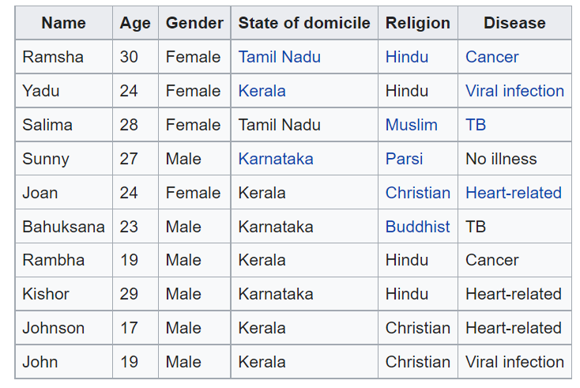
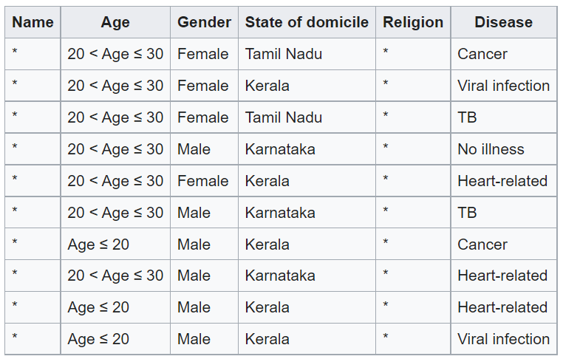
K Anonymity Example
2 - Anonymity
https://en.wikipedia.org/wiki/K-anonymity
Notes:
For K anonymity there are two steps are performed. 1st step is Suppresion where value of column is replaced by an asterisk *. In our example we will apply this on Name and Religion as it is very confidential information. And then 2nd step is Generalization where values of attributes are replaced by the range of category. In our example we will apply this on Age. So, this is how is looks like. This data has 2-anonymity with respect to the attributes 'Age', Gender, and State of Domicile.

Slide 36
Why won't K-Anonymity work ?
  In K-anonymity we are making cluster of similar or nearby values of attributes. So, in large amounts of data, we need to make lots of clusters, and it also has large amounts of outliers. In short, If we have large amount of data and more outliers K-anonymity method is not recommended. Therefore, for large amount of dataset Differential Privacy is preferred.
Notes:
IF there is large amount of data, differential privacy provides best solution.

Slide 37
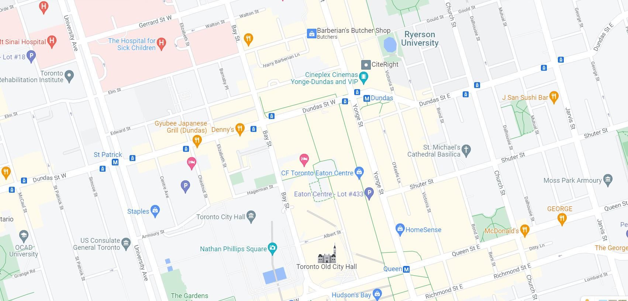
Let me explain this with Google map Example
Notes:
Here I am going to see the example from Google map. So, google wants to collect Map data so how they are applying privacy preserving techniques? Let start with K-Anonimity.

Slide 38
Thank you

